Slide 1
Context:
What is Virtual Reality?
Comparison of Different VR Headsets
Field of View
What is Augmented Reality?
What is Extended Reality?
How to build XR games for Android & Iphoes using Google Cardboard & Unity.

Slide 2
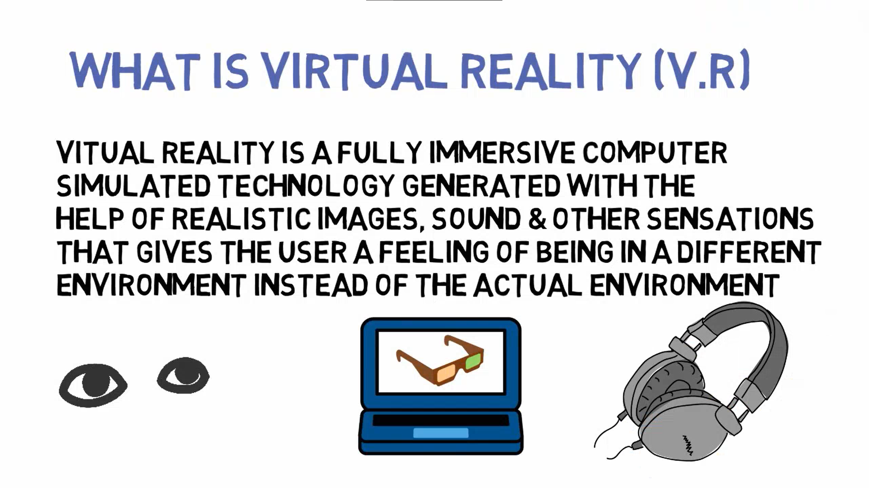

Slide 3
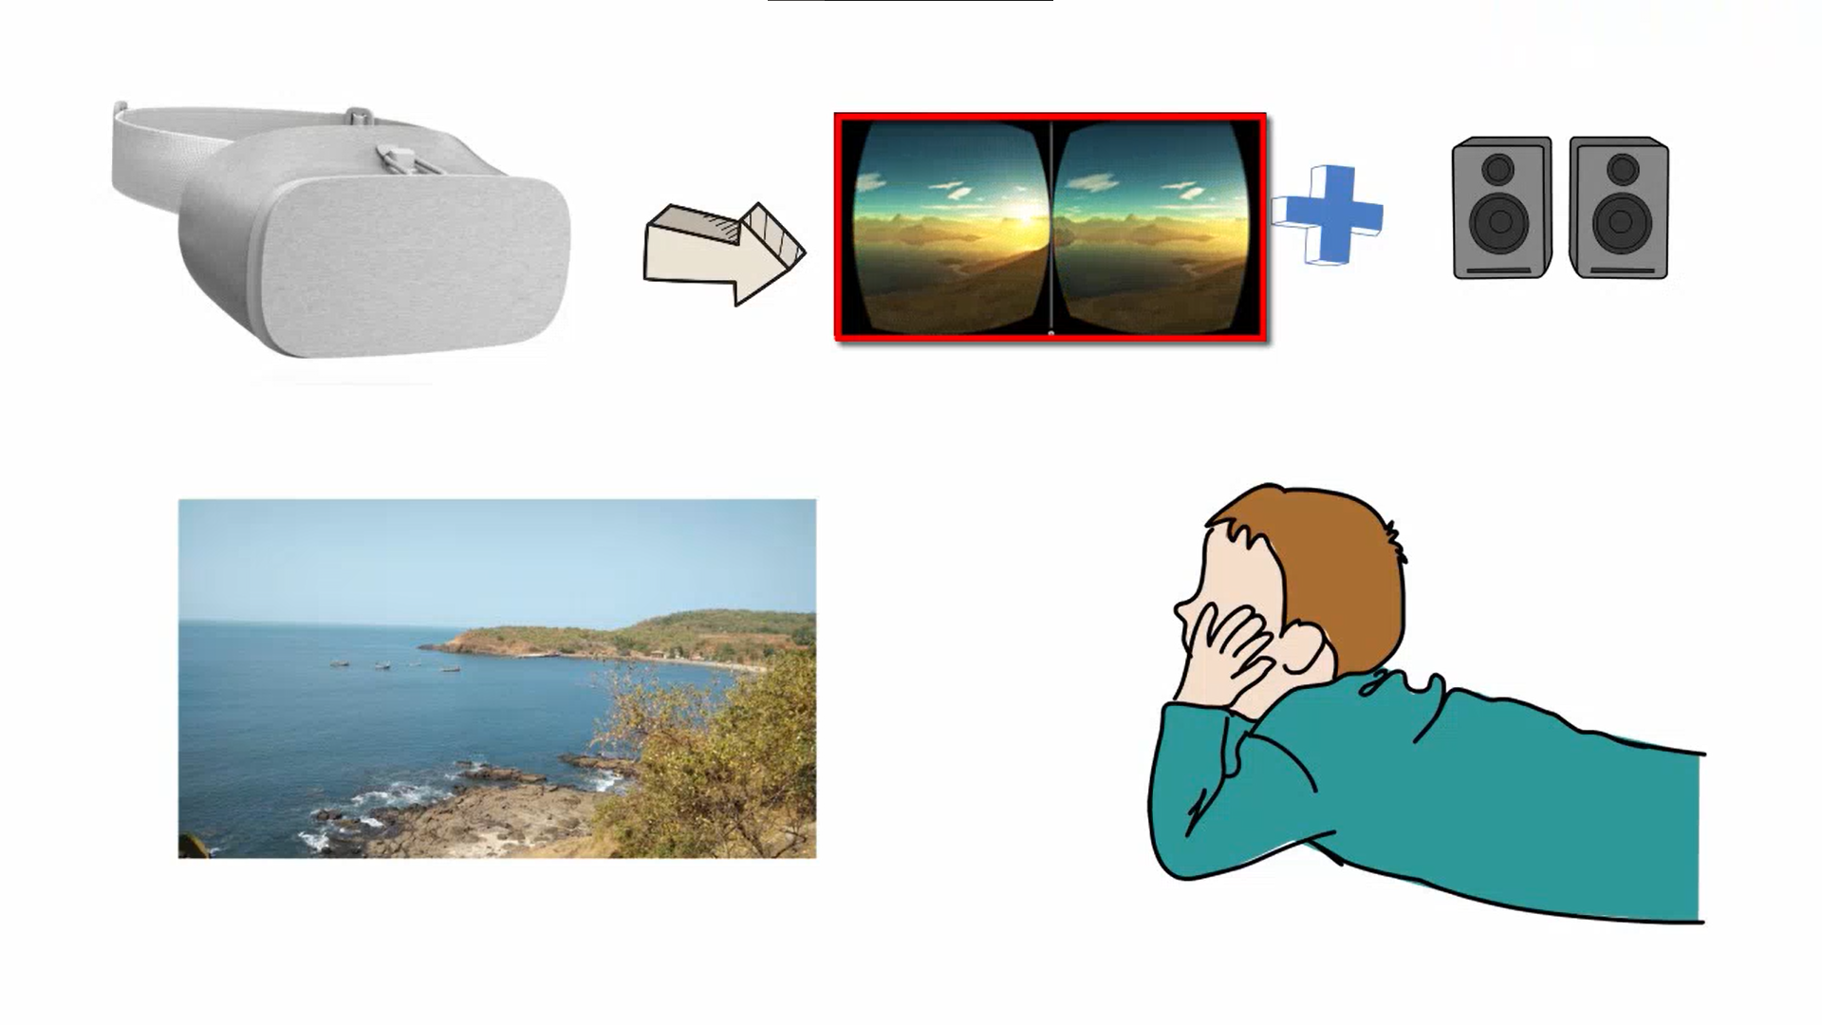
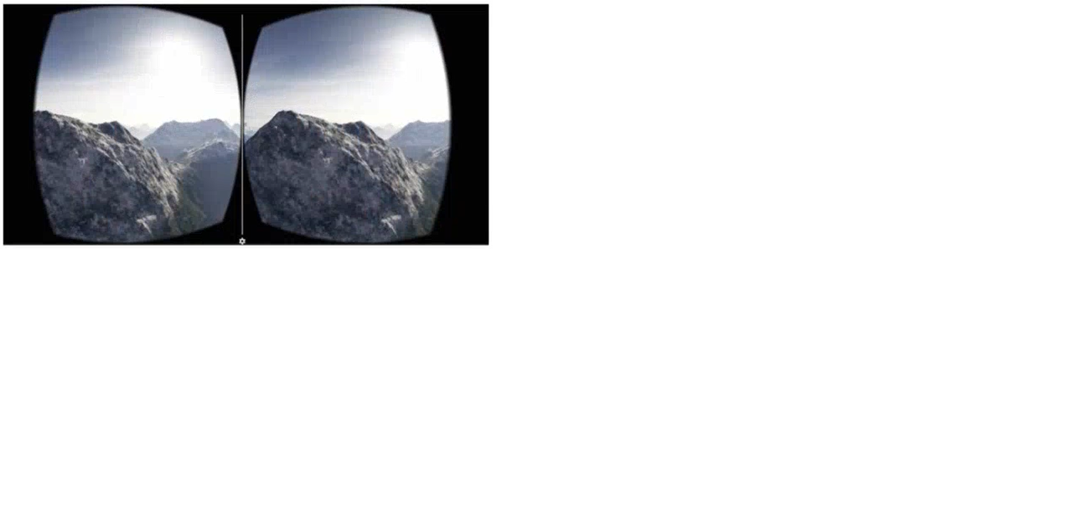



Slide 4
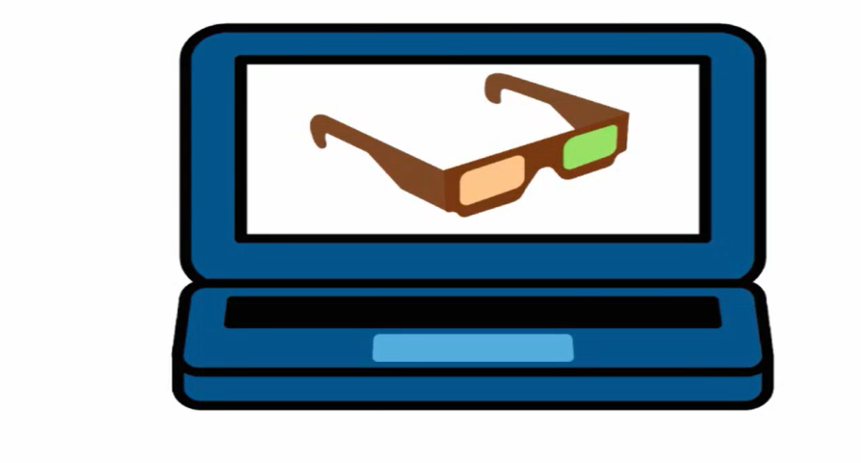

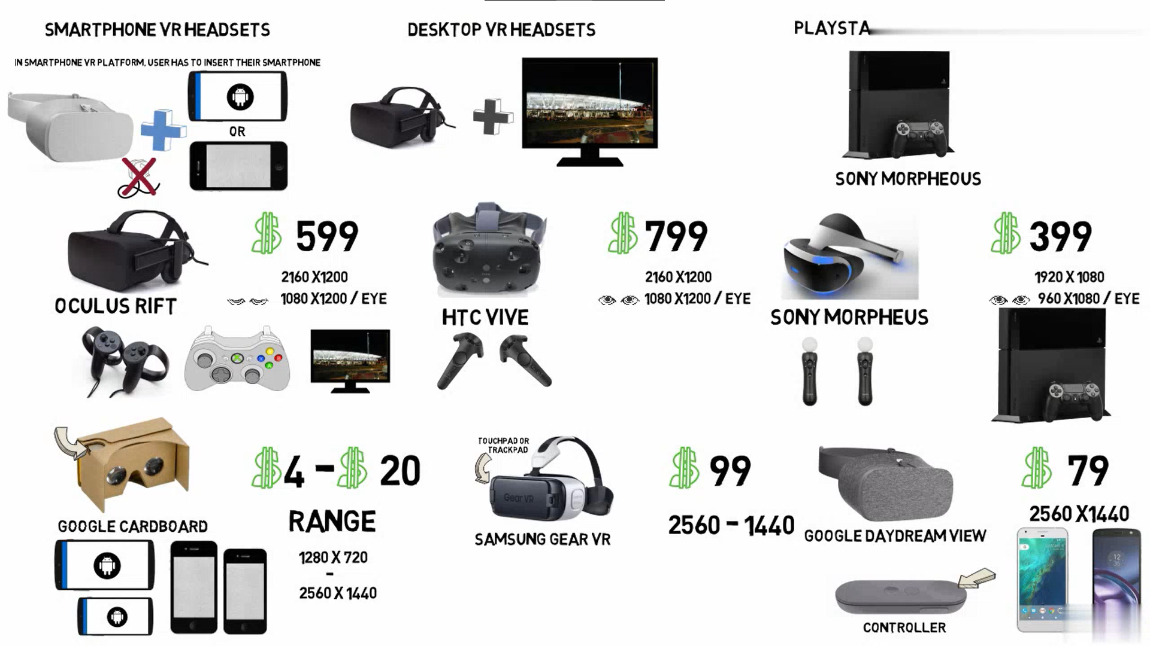
Different virtual reality headsets
Smartphone VR Headsets
Desktop VR Headsets

Slide 5
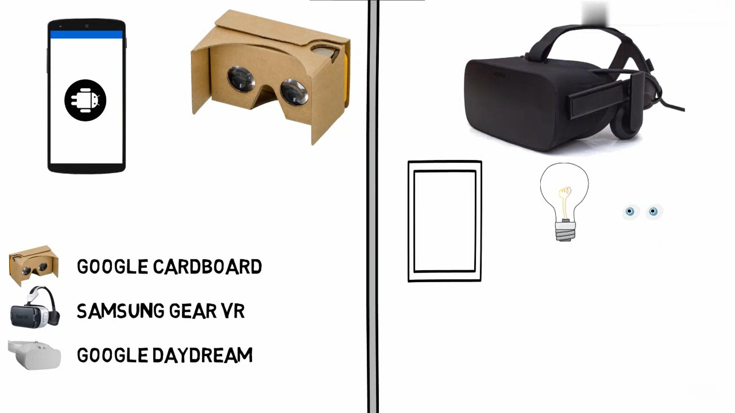

Slide 6
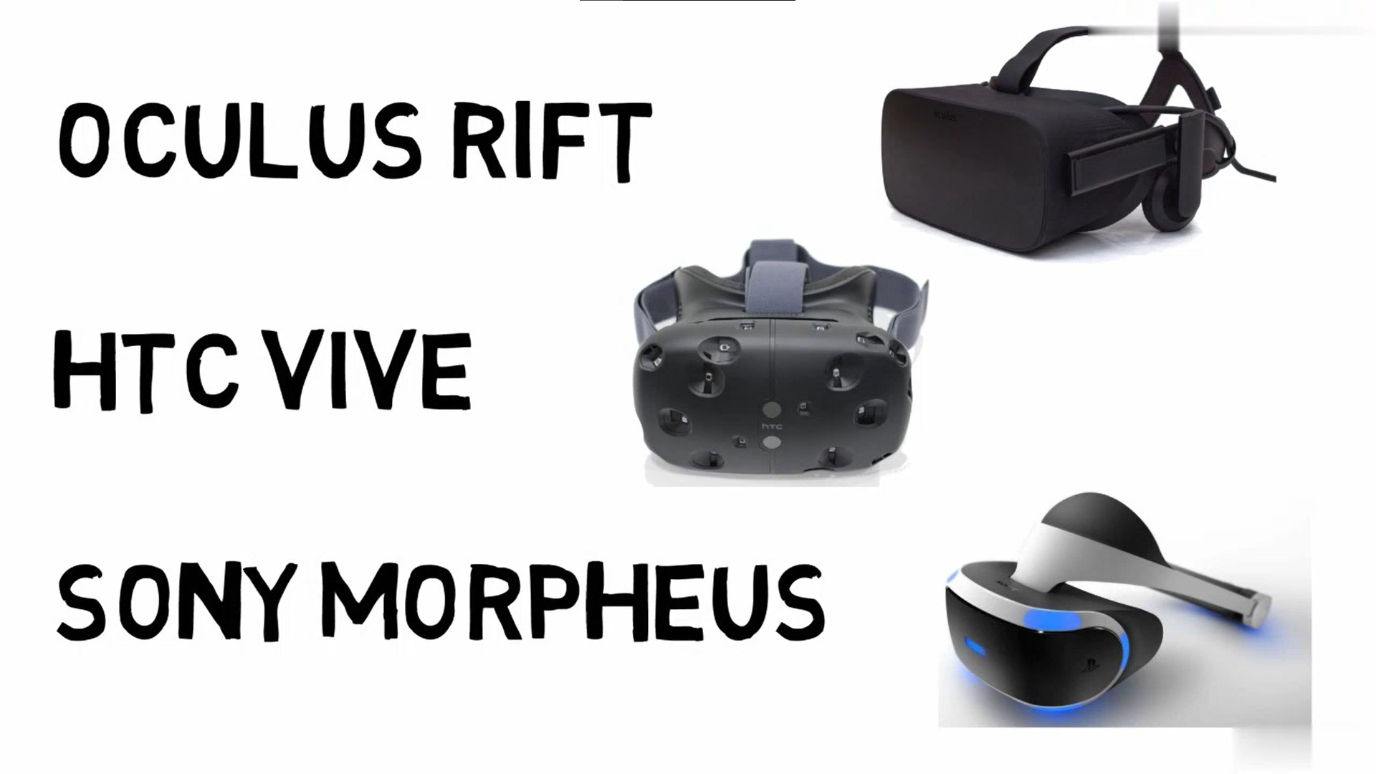
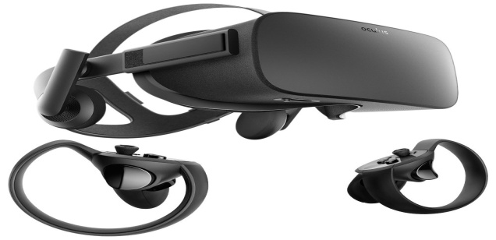
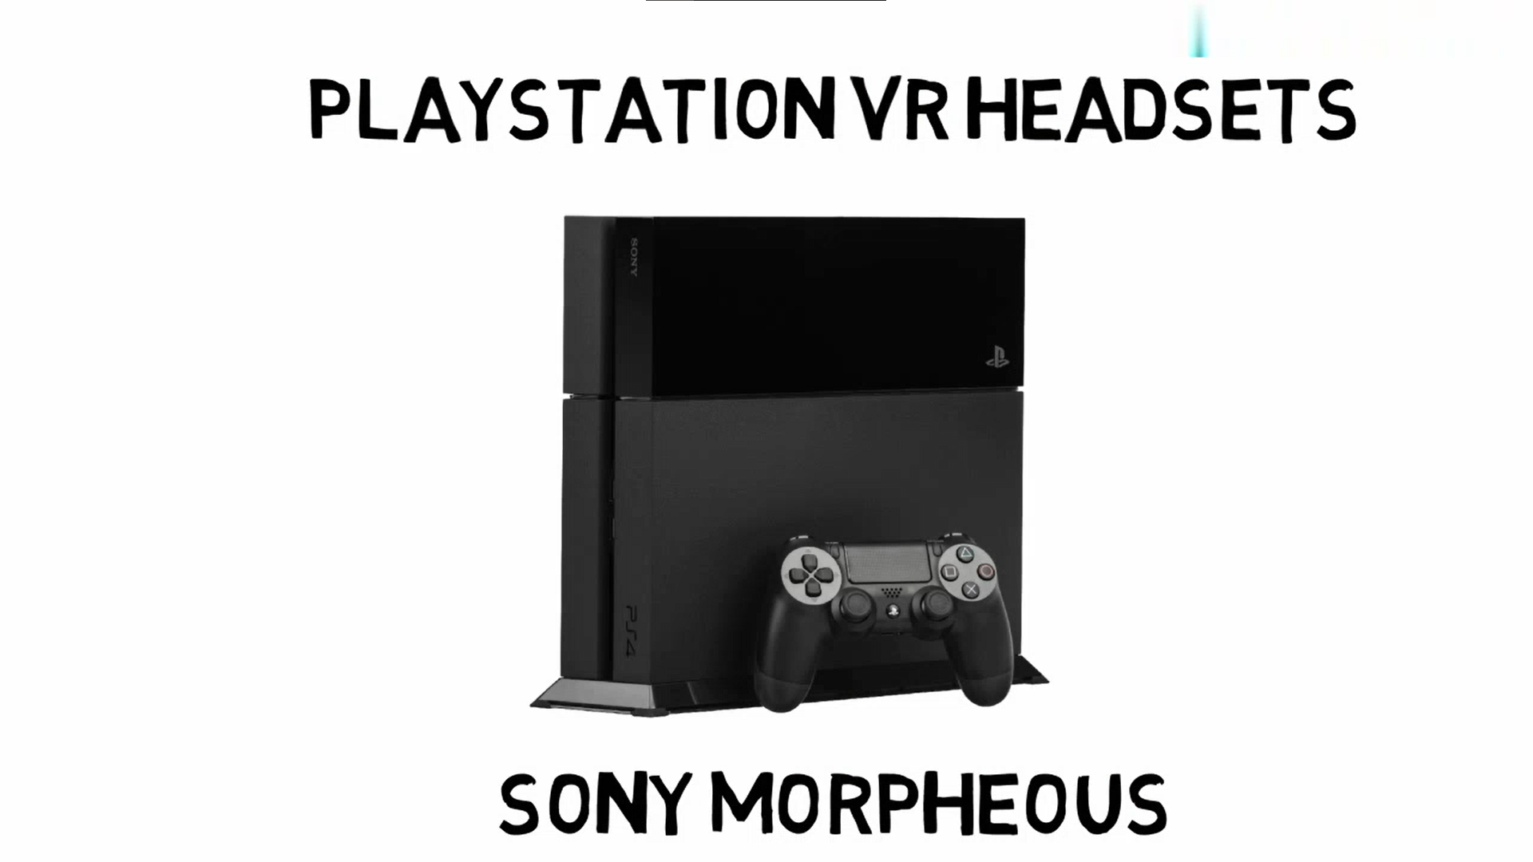
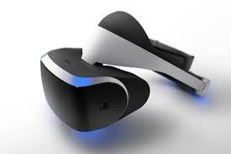

Slide 8
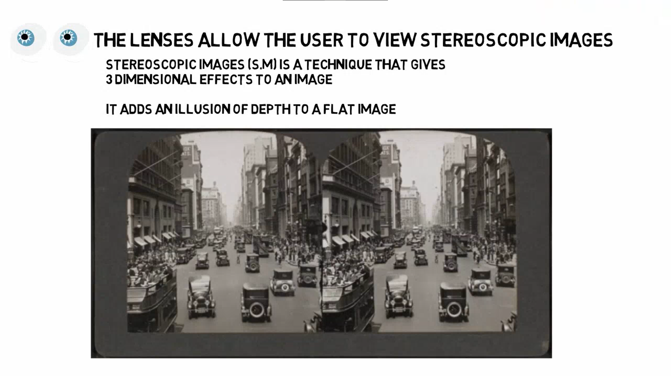

Slide 9
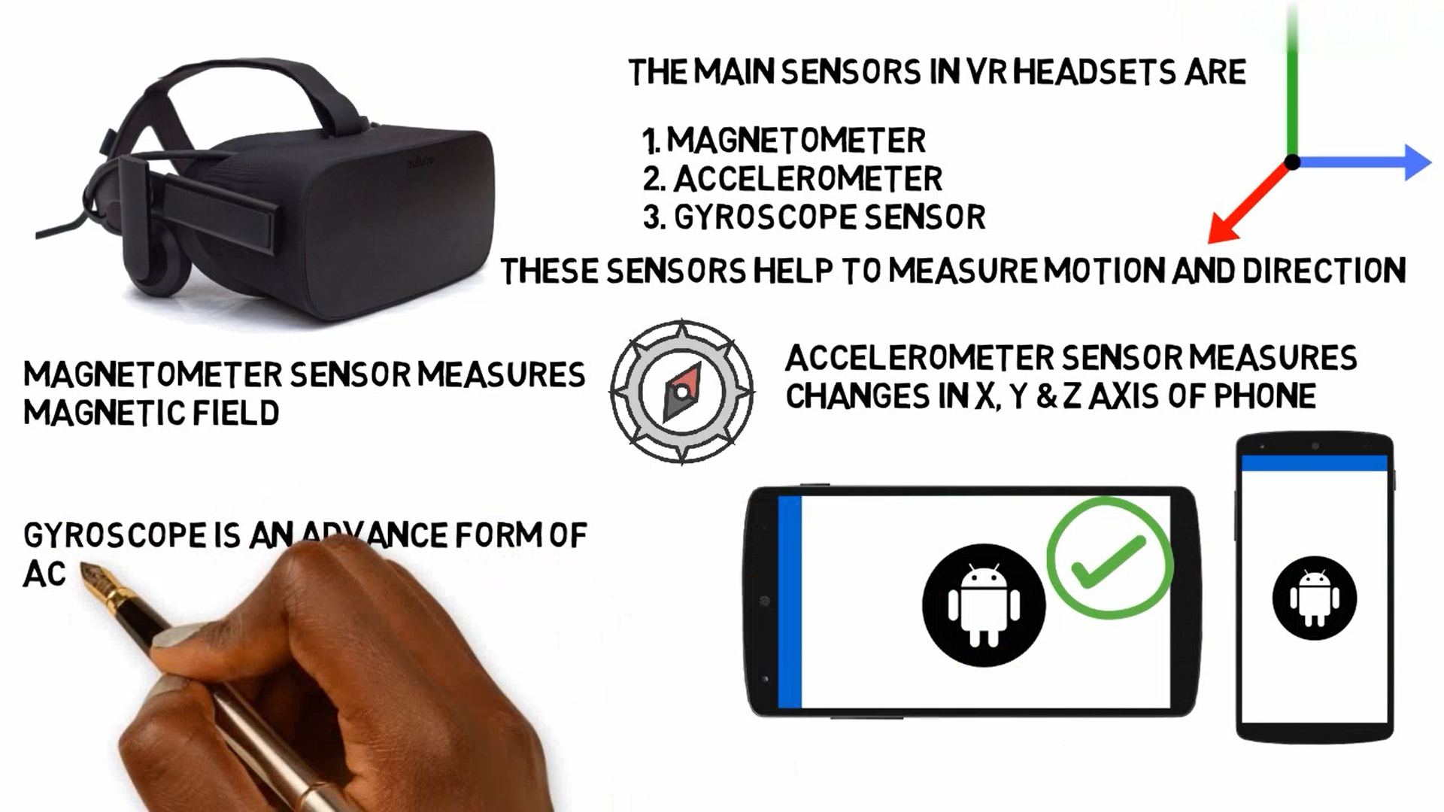
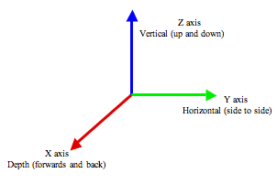


Slide 10
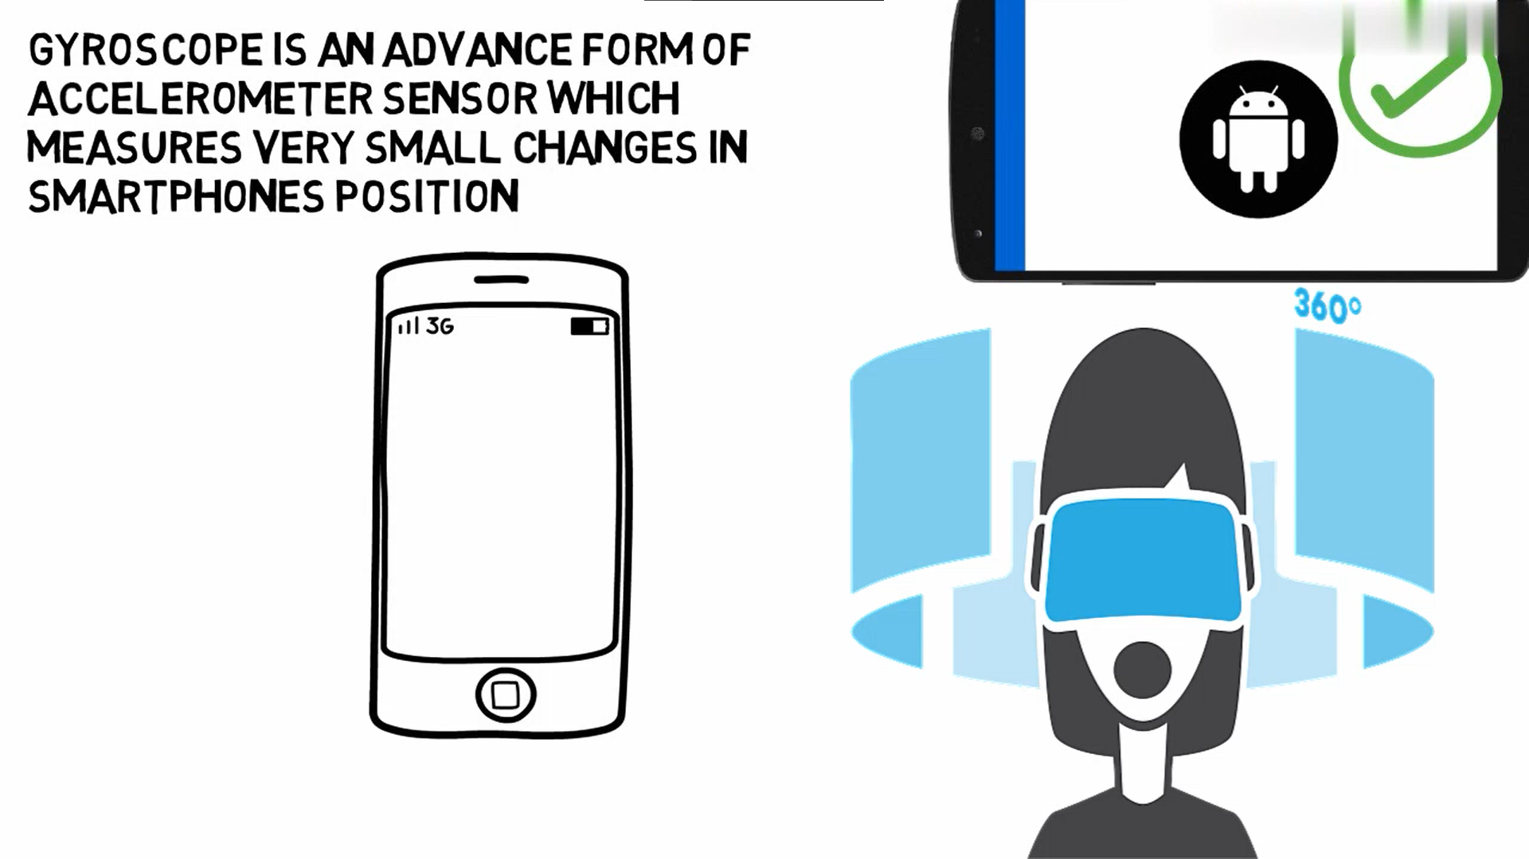

Slide 11
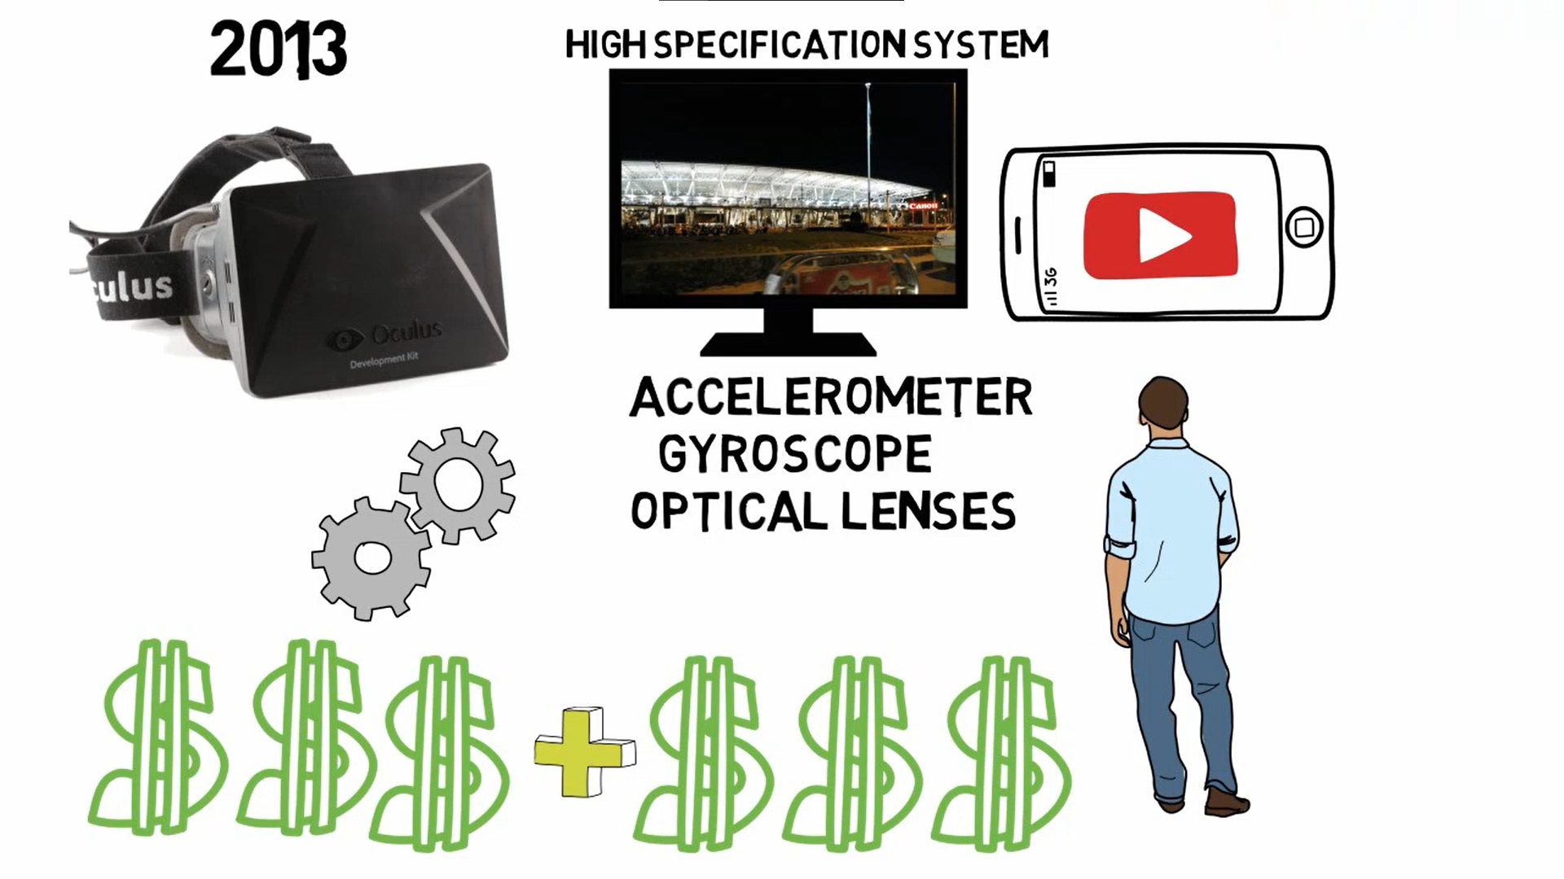

Slide 12
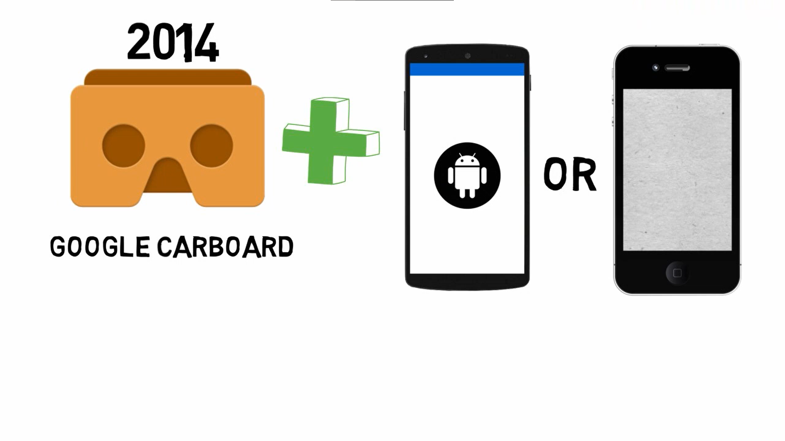
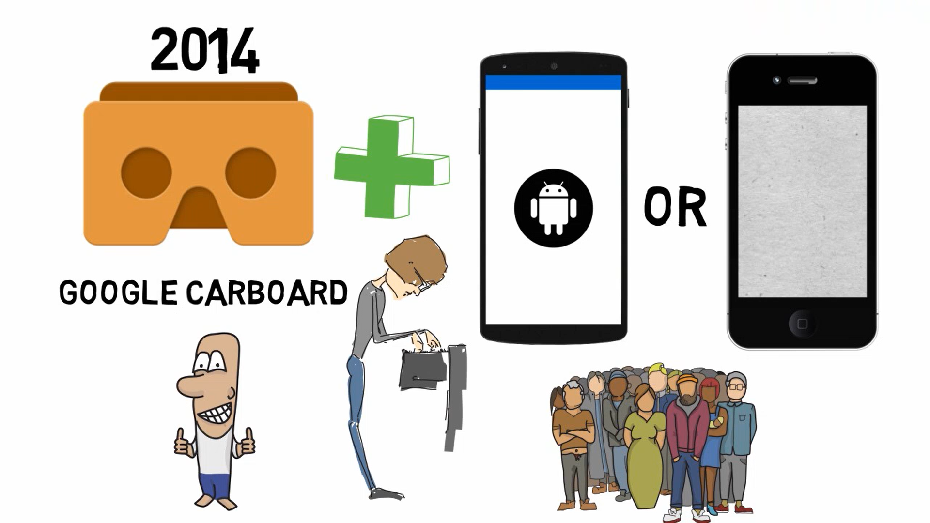

Slide 14
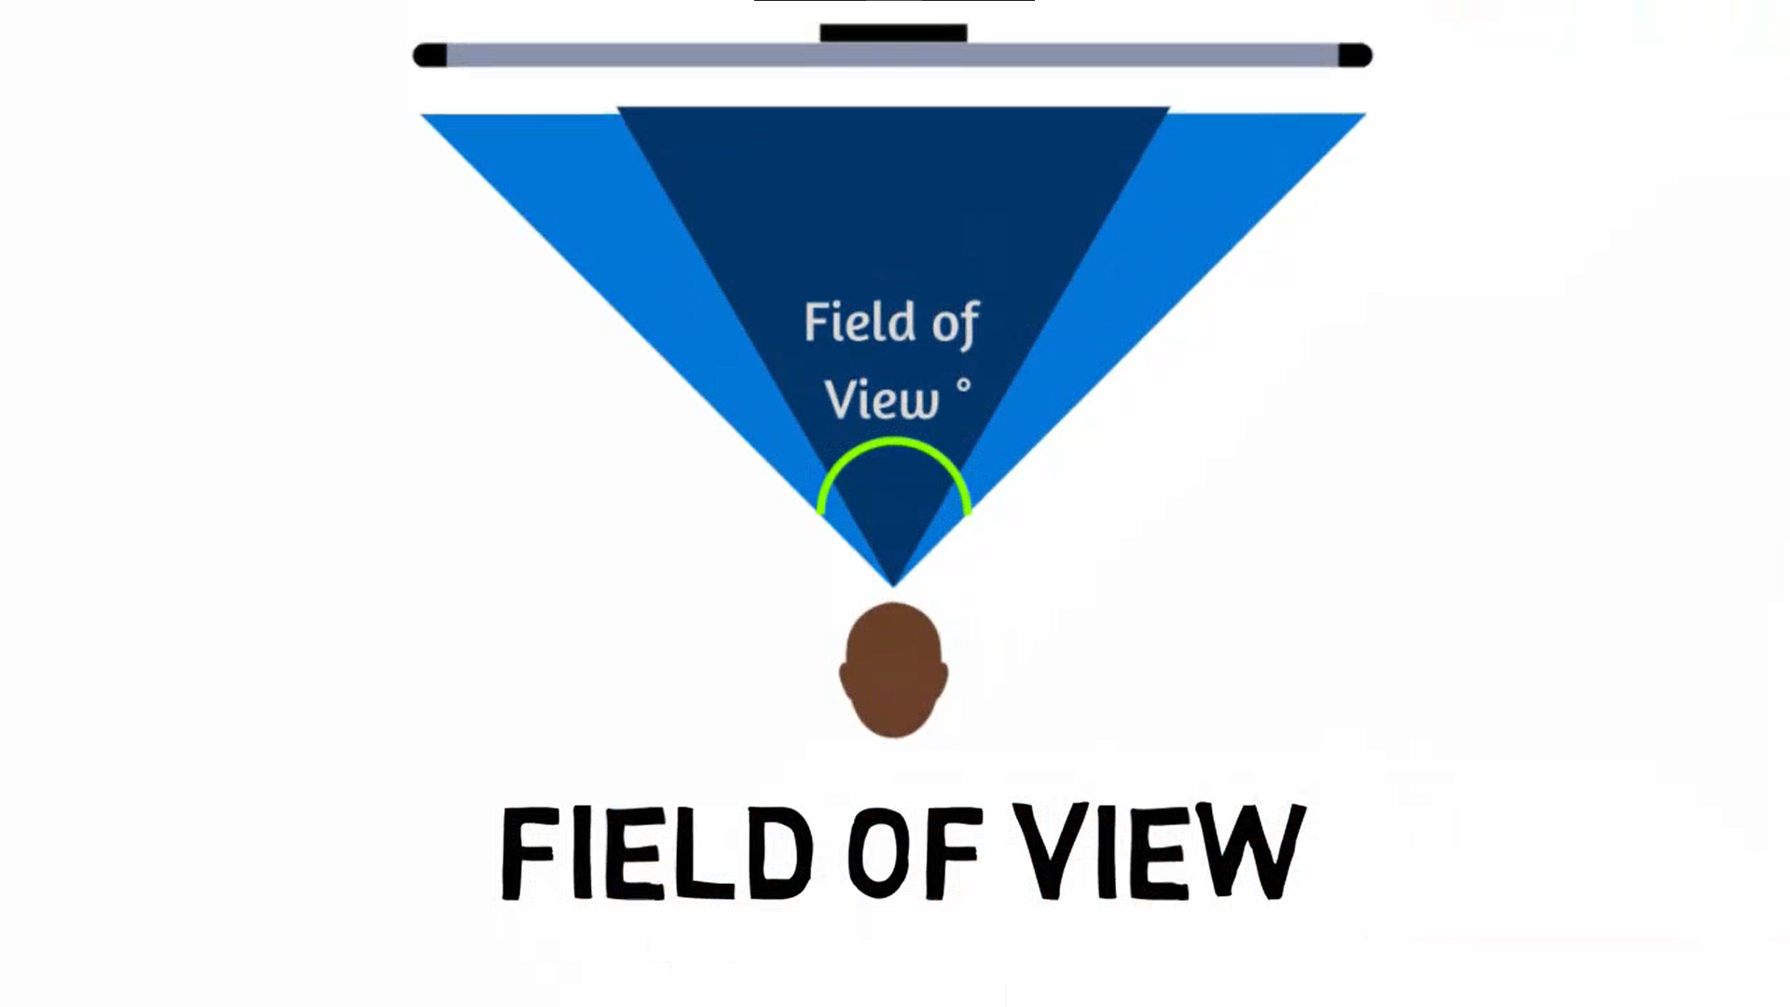

Slide 15
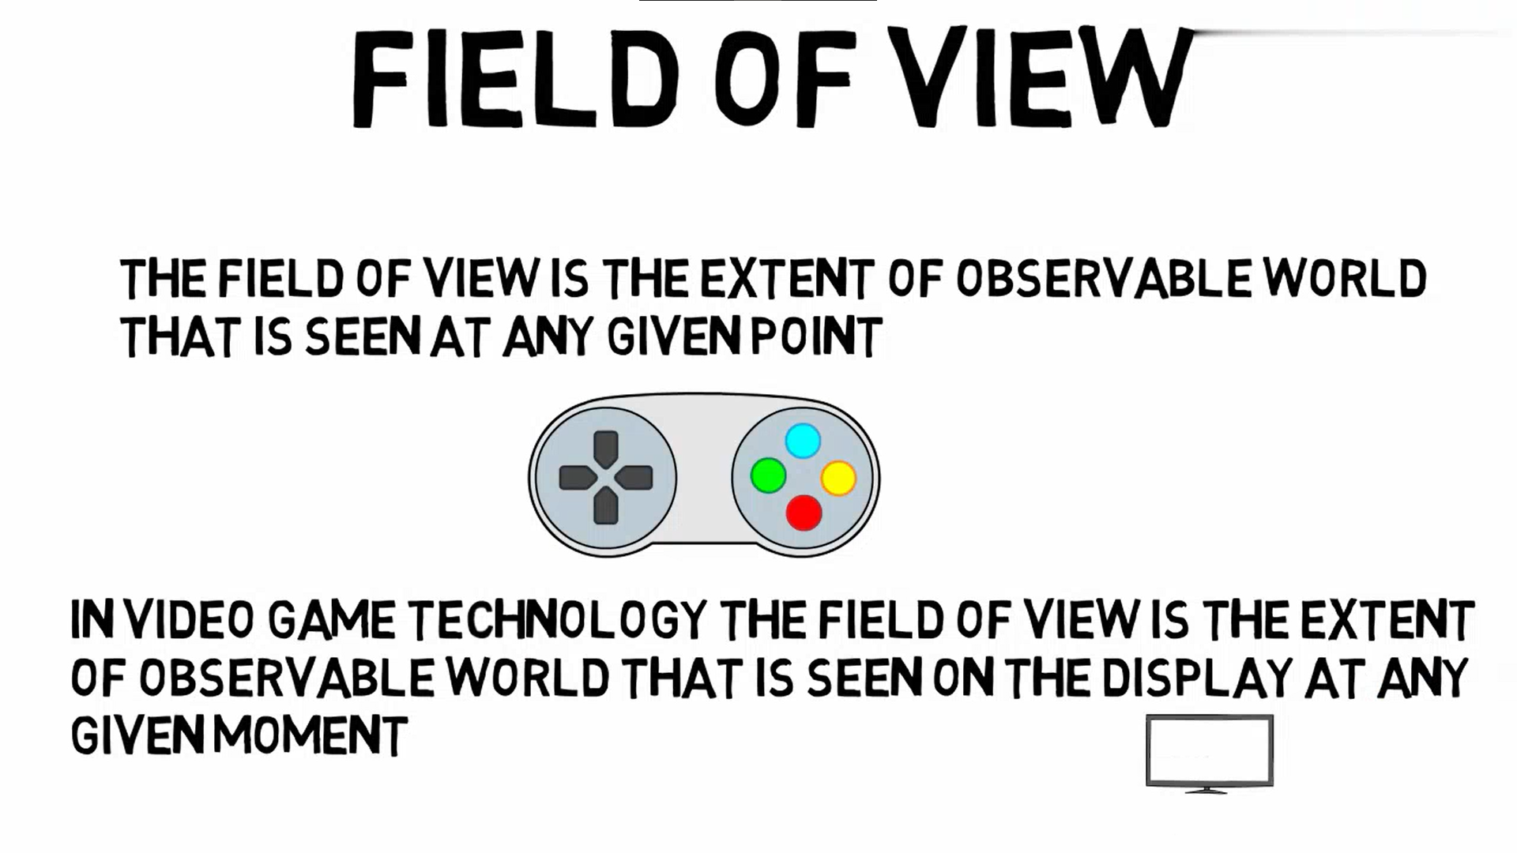

Slide 16
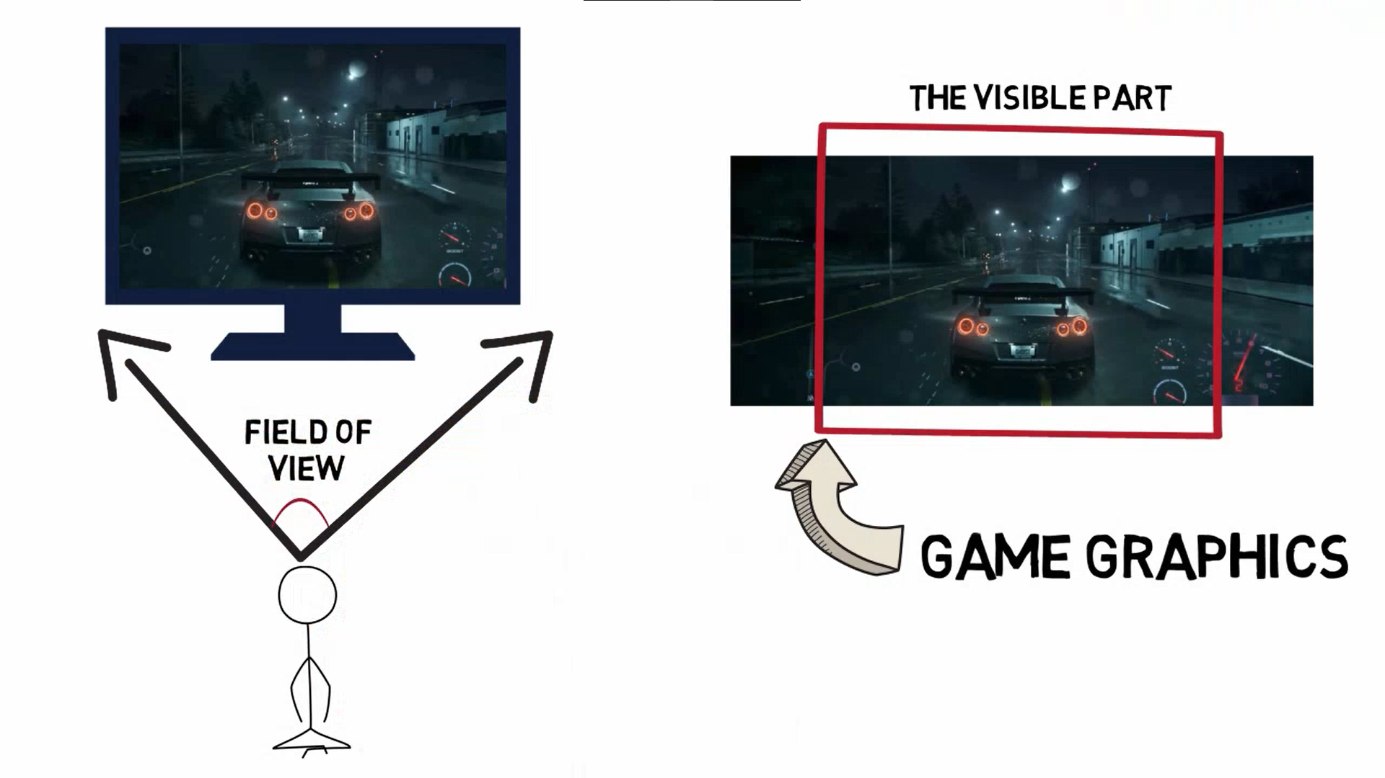

Slide 17
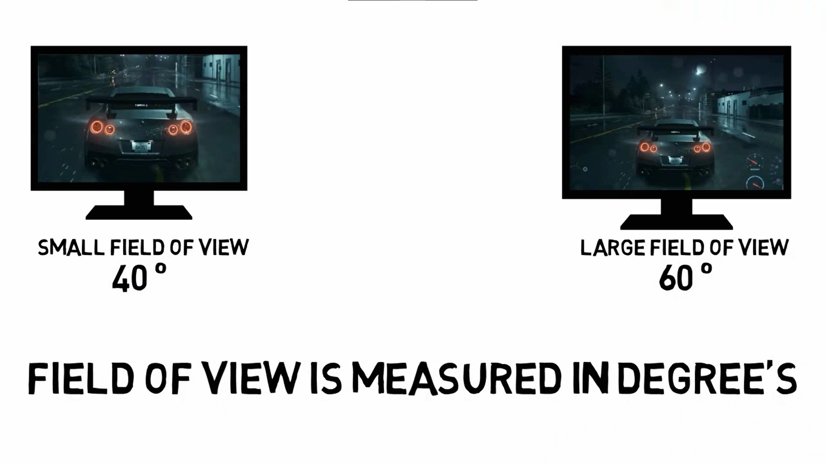

Slide 18
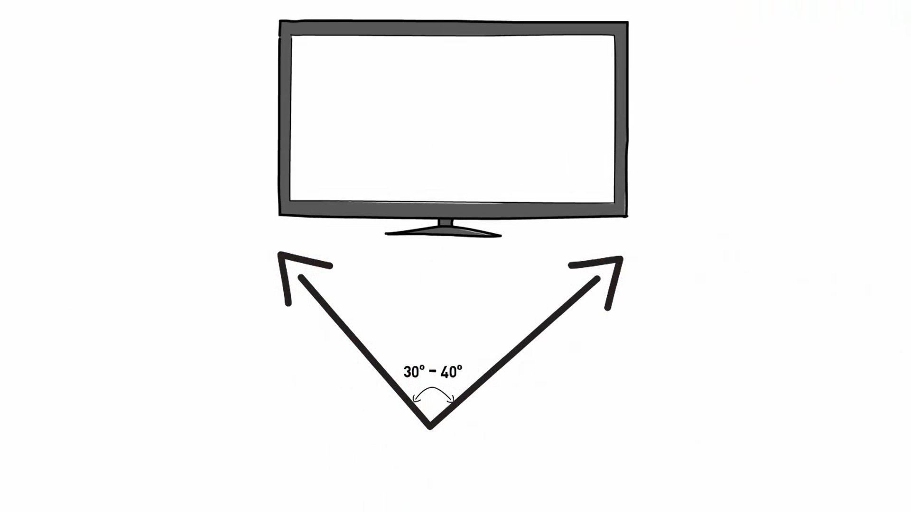

Slide 19
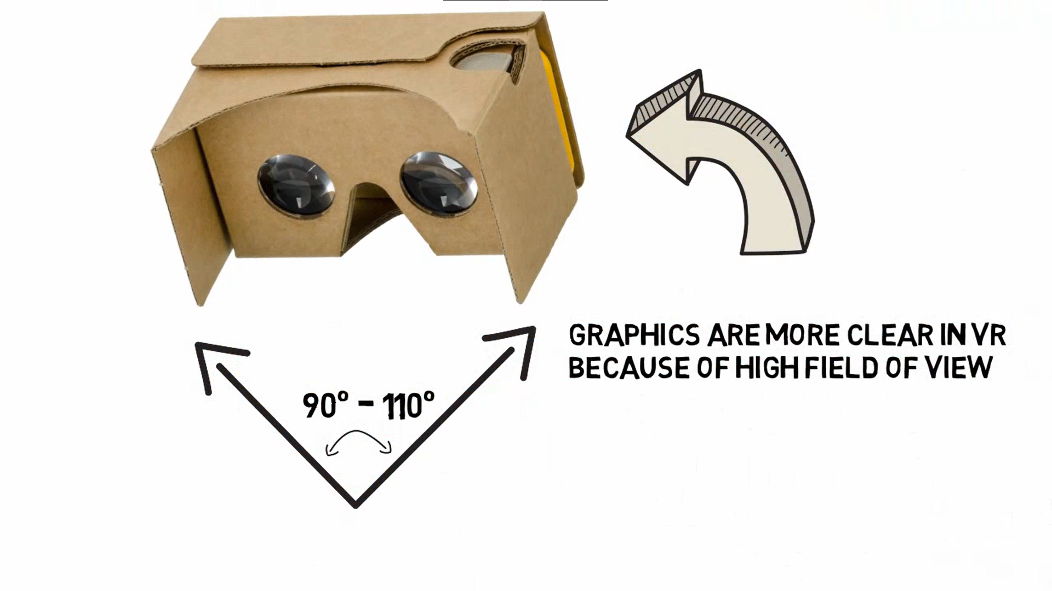

Slide 20
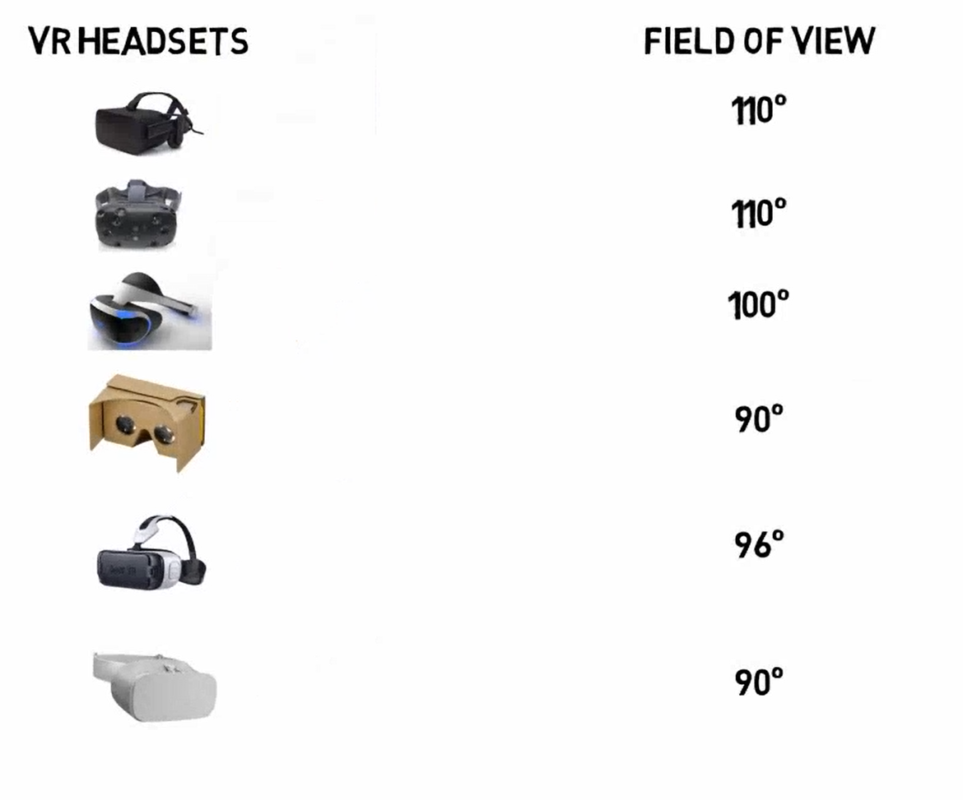

Slide 21
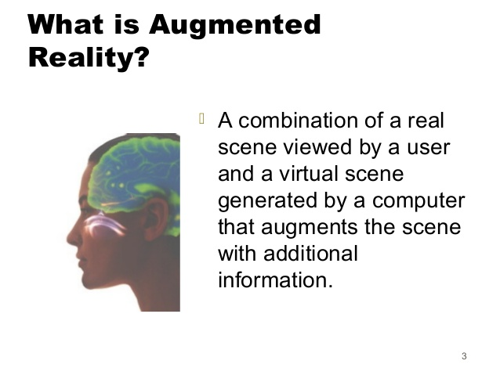
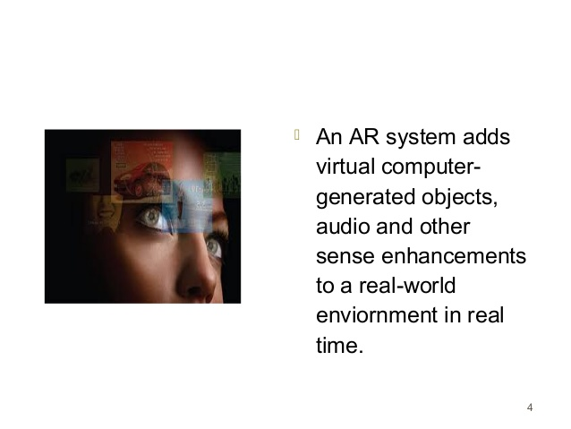
What is Augmented Reality?
A combination of a real scene viewed by a user and a virtual scene generated by a computer that augments the scene with additional information.
An AR system adds virtual computer generated objects, audio and other sense enhancements to a real-world environment in real time.

Slide 22
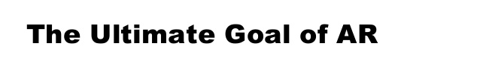
Crate a system such that a user CANNOT tell the difference between the real world and the virtual augmentation of it.

Slide 23
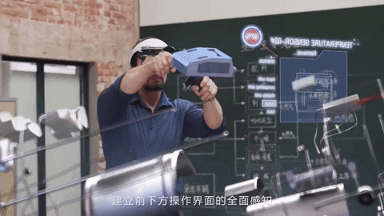
What is Mixed Reality?
It is the merging of real and virtual world to produce new Environments and visualizations where physical and digital objects co-exist and interact in real time

Slide 24
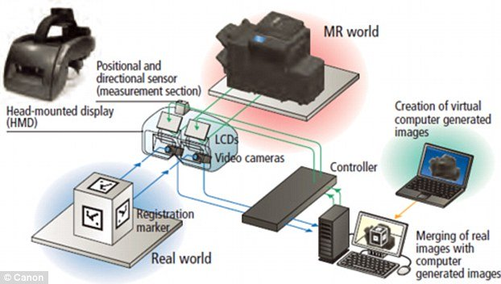
How it works?
Mixed Reality use a projector for displaying images on semitransparent materials which will then reflected to the eye with the help of beam-splitting technology.

Slide 25
Disadvantages of MR
Advantages of MR
Experience good
Detail view
Effective communication easily
overcoming HMD camera limitations
etc
High cost
Environment is not trained real
You should not share the communication in group
We cant touch in real
etc

Slide 26
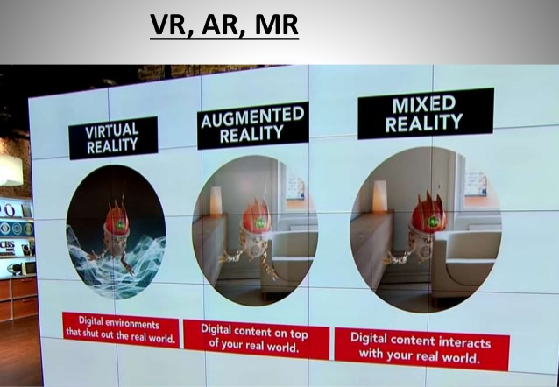

Slide 27
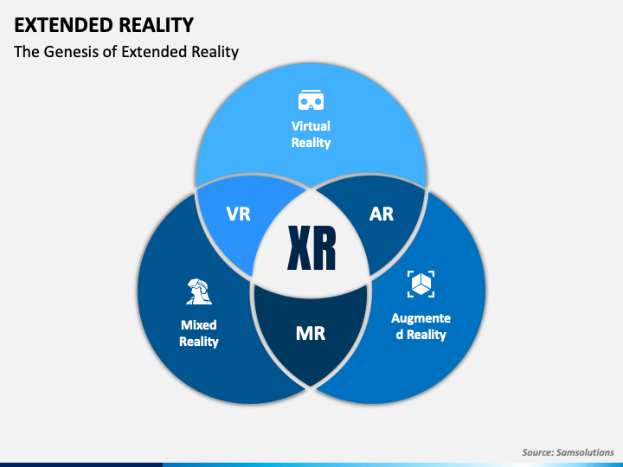

Slide 28
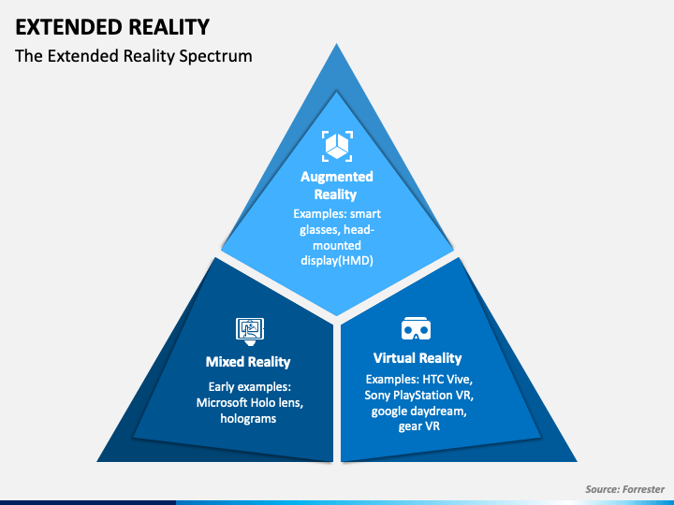

Slide 29
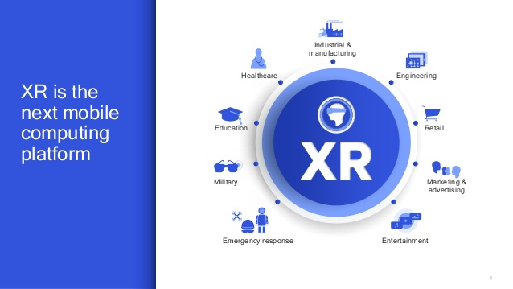

Slide 30
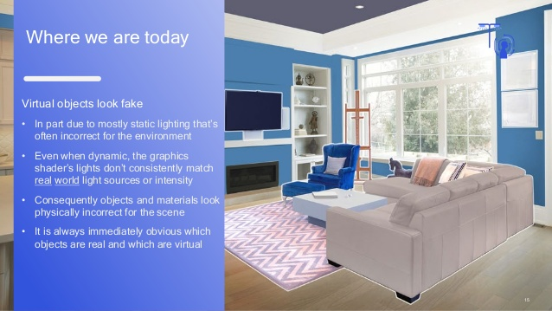

Slide 31
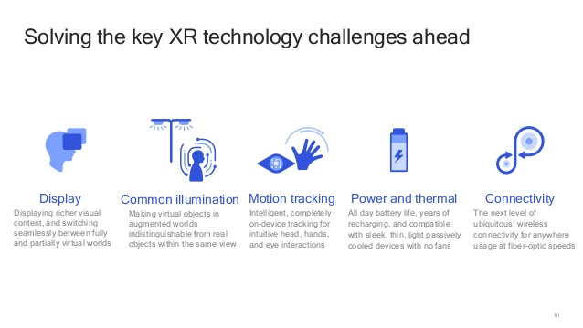

Slide 32
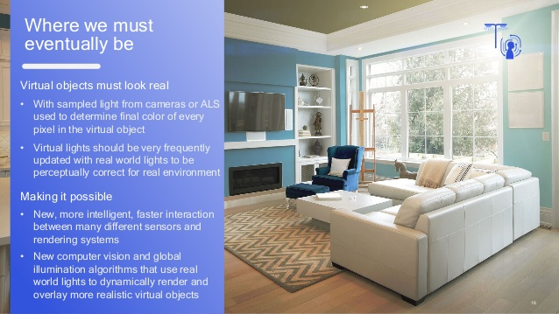

Slide 33
